Slide 1
AN EFFICIENT APPROACH FOR THE DETECTION AND
PREVENTION OF GRAY-HOLE ATTACKS IN VANETS

Slide 2
CONTENTS
Abstract
Objective
Introduction
Literature Survey
Existing System
Proposed System
Hardware / Software Requirements
Partial Output
References

Slide 3
ABSTRACT
This research proposes an innovative and efficient approach for the detection and prevention of Gray-Hole attacks in Vehicular Ad Hoc Networks (VANETs).
Gray-Hole attacks pose a significant threat to the reliability and security of VANETs by selectively dropping or modifying network packets. Our approach employs a combination of anomaly detection techniques and dynamic trust management to identify suspicious nodes exhibiting abnormal behavior indicative of Gray-Hole attacks.
Upon detection, a proactive prevention mechanism is triggered to isolate and mitigate the impact of compromised nodes.
The proposed solution is implemented in Network Simulator 2 (NS-2) using Tcl programming language, demonstrating its feasibility and effectiveness in enhancing the resilience of VANETs against Gray-Hole attacks.
The results showcase improved network performance and security, making our approach a valuable contribution to the field of VANET security.

Slide 4
OBJECTIVE
The primary objective of this research is to develop a robust solution for the detection and prevention of Gray-Hole attacks in Vehicular Ad Hoc Networks (VANETs).
Gray-Hole attacks pose a severe threat to the integrity of communication in VANETs by selectively manipulating or dropping data packets.
This research aims to enhance the security and reliability of VANETs by employing innovative anomaly detection techniques and dynamic trust management mechanisms.
The ultimate goal is to provide an efficient and effective means of identifying and mitigating Gray-Hole attacks in real-time, thereby safeguarding the communication infrastructure of vehicular networks.

Slide 5
INTRODUCTION
Vehicular Ad Hoc Networks (VANETs) play a pivotal role in modern intelligent transportation systems, enabling vehicles to communicate with each other to enhance road safety and traffic efficiency.
However, the decentralized and dynamic nature of VANETs makes them susceptible to various security threats, with Gray-Hole attacks being particularly detrimental.
Gray-Hole attackers selectively disrupt communication by either dropping or modifying network packets, compromising the reliability and safety of vehicular communication.
In light of these challenges, this research introduces a comprehensive solution aimed at detecting and preventing Gray-Hole attacks in VANETs, contributing to the overall security and trustworthiness of vehicular communication networks.

Slide 6
LITERATURE SURVEY
S.NO | Author(s) | Title & Name of the Journal | Year | Remarks
1. | Abdul Malik , Muhammad Zahid Khan , Mohammad Faisal | An Efficient Dynamic Solution for the Detection and Prevention of Black Hole Attack in VANETs | 2021 | Resource Overhead Adaptability to Evolving Threats
2. | POOJA RANI , KAVITA | Mitigation of Black Hole and Gray Hole Attack Using Swarm Inspired Algorithm With Artificial Neural Network | 2020 | real-world deployment could pose challenges related to hardware compatibility, energy efficiency, and robustness in dynamic and unpredictable MANET environments.

Slide 7
S.NO | Author(s) | Title & Name of the Journal | Year | Remarks
3. | Ankit Kumar , Vijayakumar Varadarajan | Black hole attack detection in vehicular ad-hoc network using secure AODV routing algorithm | 2021 | As the number of vehicles and network nodes increases, the overhead associated with the modified protocol may become prohibitive, affecting scalability and overall network performance.
4. | Shamim Younas 1,Faisal Rehman | Collaborative Detection of Black Hole and Gray Hole Attacks for Secure Data Communication in VANETs | 2022 | This increased complexity could impact the real-time performance and responsiveness of the system, which is critical for ensuring the safety of autonomous and connected vehicles.

Slide 8
S.NO | Author(s) | Title & Name of the Journal | Year | Remarks
5. | Tushar Pokar1, Prof. Shreya Patel2 & Prof. Rakesh Shah | An Efficient Approach Of Dsr Protocol To Detect And Prevent Black Hole Attack For Vanet | 2019 | Managing communication and coordination among a large number of vehicles and street-side units can become increasingly challenging and may impact the scalability of the system.
6. | Gurtej Kaur, Meenu Khurana, Amandeep Kaur | Gray Hole Attack Detection and Prevention System in Vehicular Ad-Hoc Network (VANET) | 2021 | Limited Scope

Slide 9
EXISTING SYSTEM
In the current landscape of Vehicular Ad Hoc Networks (VANETs), security remains a critical concern due to the susceptibility to various attacks, including the Gray-Hole threat.
Existing systems often rely on conventional security mechanisms, such as encryption and authentication, to safeguard communication channels.
These methods may fall short in detecting and preventing sophisticated attacks like Gray-Hole, which involve nodes selectively manipulating or dropping packets without overtly violating encryption or authentication protocols.
Traditional approaches may lack the adaptability required to address the dynamic nature of VANETs, where nodes frequently join or leave the network.
There is a pressing need for an advanced system that goes beyond conventional security measures and provides a comprehensive solution to identify and mitigate Gray-Hole attacks effectively in VANETs.

Slide 10
EXISTING SYSTEM DRAWBACK
Limited Detection Capabilities
communication bandwidth Overhead
False Positives/Negatives
Scalability Issues

Slide 11
PROPOSED SYSTEM
The proposed system for the detection and prevention of gray-hole attacks in Vehicular Ad Hoc Networks (VANETs) employs a multifaceted approach integrating cryptographic techniques, trust management, and anomaly detection mechanisms.
It begins with the establishment of secure communication channels using cryptographic protocols to ensure data integrity and confidentiality.
A trust management system is implemented to assess the reliability of vehicles within the network based on their past behavior and interactions.
Anomaly detection algorithms continuously monitor network traffic patterns and identify any deviations indicative of gray-hole attacks, where malicious vehicles selectively drop or modify packets.
Upon detection, the system dynamically adjusts routing paths to bypass compromised nodes and redistributes trust levels accordingly to isolate malicious actors.
KNCET - DEPARTMENT OF ECE

Slide 12
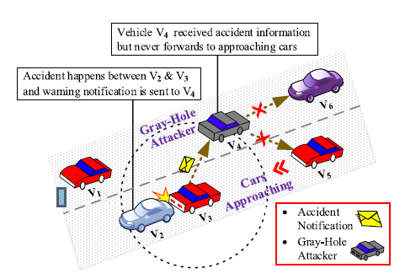
PROPOSED SYSTEM

Slide 13
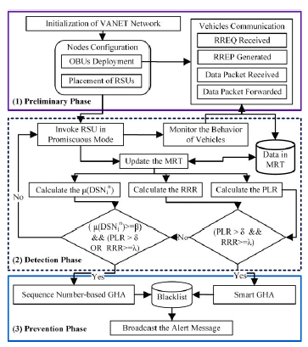
SYSTEM ARCHITECTURE

Slide 14
SYSTEM ARCHITECTURE DESCRIPTION
The proposed DPGHA is presented in detail The overall system design framework of the proposed DPGHA, its components, and operations are illustrated.
It consists of three main phases: the preliminary phase, the detection phase, and the prevention phase.
Each phase has different operations and functionalities integrated to achieve security against GHA in VANET.
we explain the preliminary phase, which contains the underlying system model of VANET, the node properties, the communication paradigm, the placement of RSUs, and some assumptions.
Detection Phase is based an AODV-based VANET, the detection phase of GHA begins. Initially, the RSU node is invoked in the promiscuous mode that periodically monitors all neighboring vehicles to determine whether various numbers of packets received by a node are passed to their next-hop nodes or not.

Slide 15
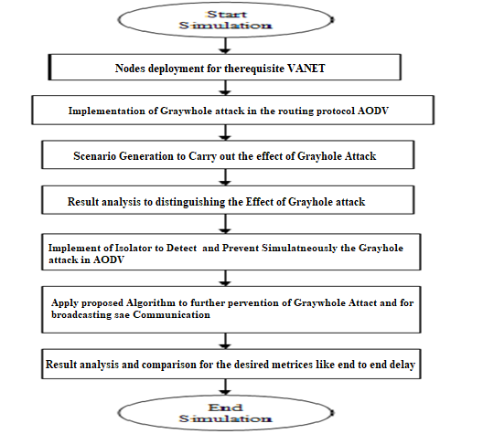
FLOW CHART

Slide 16
CONT,…
Prevention phase model and network scenario of the VANET discussed earlier, here in this section we explain the proposed prevention phase.
As in the detection phase, once an RSU detects a GHA it broadcasts the identity of that vehicle to all its neighboring nodes via an alert Message.
The alert message contains the issuing identity of an RSU, the identity of the GHA, the type of GHA, and the time of identification.

Slide 17
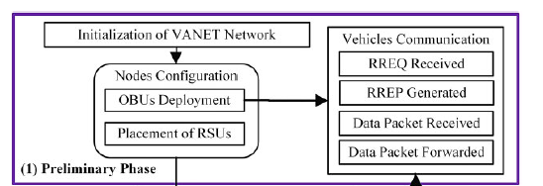
PRELIMINARY PHASE
The proposed DPGHA is presented in detail The overall system design framework of the proposed DPGHA, its components, and operations are illustrated.
It consists of three main phases: the preliminary phase, the detection phase, and the prevention phase. Each phase has different operations and functionalities integrated to achieve security against GHA in VANET.
we explain the preliminary phase, which contains the underlying system model of VANET, the node properties, the communication paradigm, the placement of RSUs, and some assumptions.

Slide 18
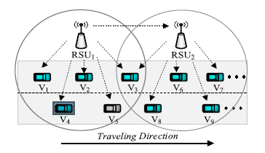
DETECTION PHASE
Keeping in mind the above system model and design framework for an AODV-based VANET, the detection phase of GHA begins.
Initially, the RSU node is invoked in the promiscuous mode that periodically monitors all neighboring vehicles to determine whether various numbers of packets received by a node are passed to their next-hop nodes or not.
To detect Smart GHA, an RSU counts the number of packets received, forwarded, and generated by each neighboring node and stores them in the MRT Table.

Slide 19
PREVENTION PHASE
Keeping in view the system model and network scenario of the VANET discussed earlier, here in this section we explain the proposed prevention phase.
As in the detection phase, once an RSU detects a GHA it broadcasts the identity of that vehicle to all its neighboring nodes via an alert
Message.
The alert message contains the issuing identity of an RSU, the identity of the GHA, the type of GHA, and the time of identification.
When a node (RSU or vehicle) receives an alarm message from an RSU, it first examines its blacklist table for a GHA entry.
KNCET - DEPARTMENT OF ECE

Slide 20
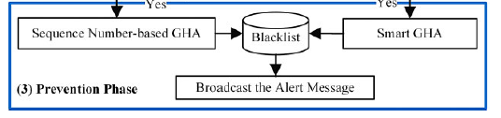
PROCESS DIAGRAM

Slide 21
CLUSTER CREATIONS
Cluster Formation:
Cluster formation is the process of grouping the nodes in to a single is known as cluster formation. This cluster has n number of nodes those are having same characteristics and also they are in the single area. This group of single nodes forms the network. There are lot of clusters comes under a base station.
Cluster Head Selection:
Initially, when clusters are being created, each node decides whether or not to become a cluster head for each round as specified by the original LEACH protocol. Each self-selected cluster head, broadcasts an advertisement (ADV) message using non-persistent carrier sense multiple access (CSMA) protocol. The message contains the header identifier (ID).
Cluster Setup:
Each non-cluster head node chooses one of the strongest received signal strength (RSS) of the advertisement as its cluster head, and transmits a join-request (Join-REQ) message back to the chosen cluster head. The information about the node’s capability of being a cooperative node, that is, its current energy status is added into the message. If a cluster head receives the advertisement message from another cluster head y, and if the received RSS exceeds a threshold, it will mark cluster head y as the neighboring cluster head and it record ID. If the sink receives the advertisement message, it will find the cluster head with the maximum RSS, and sends the sink-position message to that cluster head marking it as the target cluster head (TCH).

Slide 22
Gray Whole detection
In this step we finding smallest or large disjoint block. Search and Place algorithm is distributed and light weight.
The boundary nodes are detected by that are struck nodes, which will launch the Warm whole discovery and the healing process even if these nodes are actually not stuck nodes.
In order to differentiate the network border and hole border we are comparing coordinate value of nodes.
Topological hole and border detection methods are simple distributed approach to locate nodes near the boundary of the sensor field and the hole boundaries.
This method purely relay on the topology of the communication graph. Here the only information available is, whether the nodes can communicate with each other or not.
The topological methods never use the any location informations about the sensor nodes. The communication graph has node and edges if corresponding wireless station can communicate with each other.
If two nodes can communicate with each other then they come under a common communication radius.

Slide 23
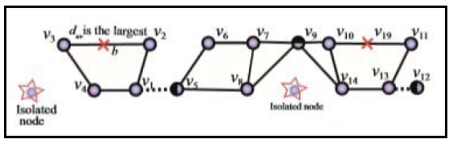
BACKUP SENSOR SELECTION
A middle point between two sensors and of a cluster is an Repair points (RP) which is with the longest and irregular transmission distance and the link between r1 and r2 is vulnerable.
Find Critical midpoint, Search an place algorithm implement to place backup sensor in an network.
The RP’s identified are provided with the backup sensors of similar configuration as primary sensors.
It improves the stability of the network by making system fault tolerant. The search for repair points runs continuously through all the clusters till all the RP’s are provided with backup sensors.

Slide 24
ADVANTAGE
Enhanced Security: By effectively detecting and preventing gray-hole attacks, the overall security of the VANET is significantly bolstered.
Improved Reliability: This is crucial for safety-critical applications such as collision avoidance systems and traffic management, where any interruption in communication can have serious consequences.
Minimized Network Overhead: The efficient approach likely optimizes resource utilization by minimizing the overhead associated with security measures.
Real-time Response: The approach is likely designed to provide real-time detection and response to gray-hole attacks.
Scalability: The approach is scalable, meaning it can effectively handle a growing number of vehicles and network nodes without compromising its performance.
Adaptability: An efficient approach would likely incorporate machine learning or anomaly detection techniques to identify emerging attack patterns.

Slide 25
SOFTWARE REQUIREMENTS
TOOLS REQUIRED:
Simulation Tool: NS2.34
Language:
  Front End: TCL (Tool Command Language)
  Back End: C++
Software: Network Simulator version-2 ,VMware
Operating System: Linux (Ubuntu 10.04)

Slide 26
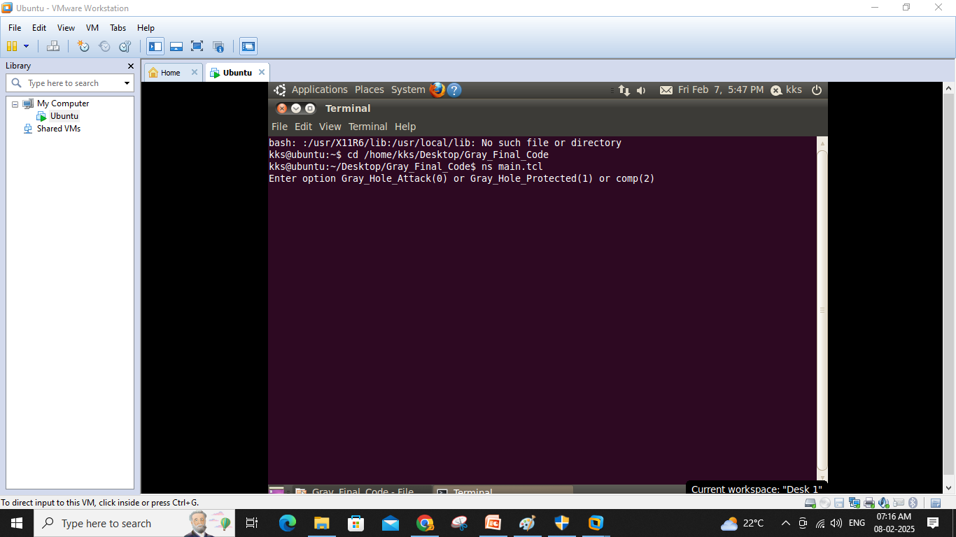
SIMULATION RESULT ON NS2 TOOL

Slide 27
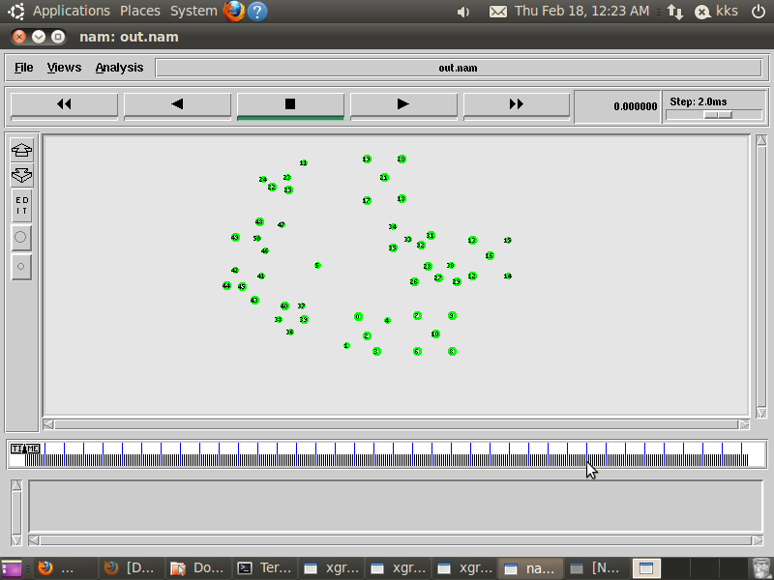
NODE CREATION

Slide 28
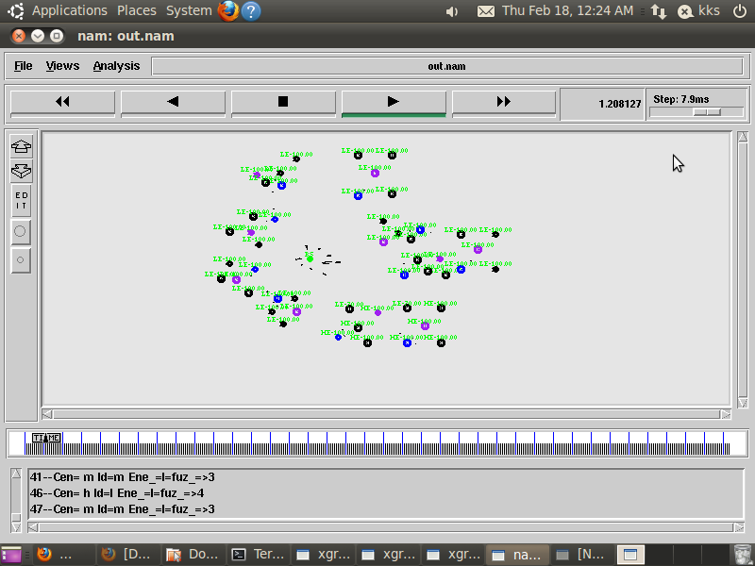
PROPOSED ALGORITHM

Slide 29
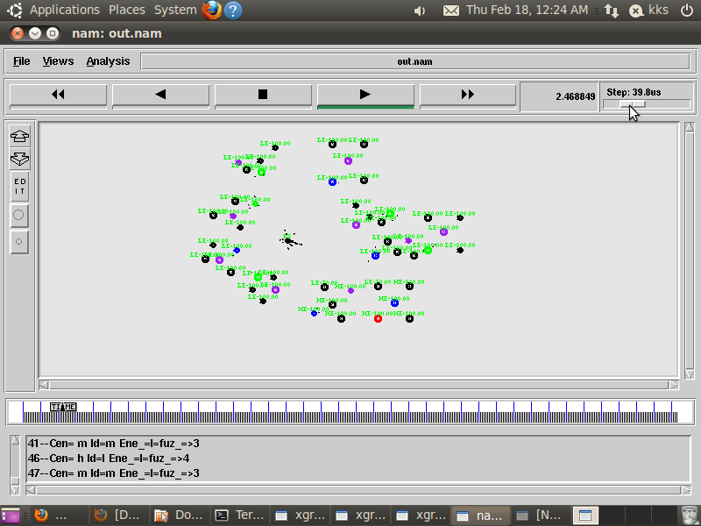
GRAY HOLE ATTACKER PRESENT

Slide 30
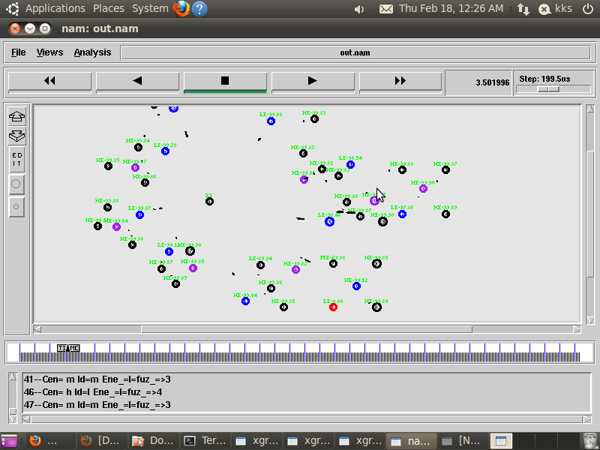
DETECTION GRAY WHOLE ATTACKER

Slide 31
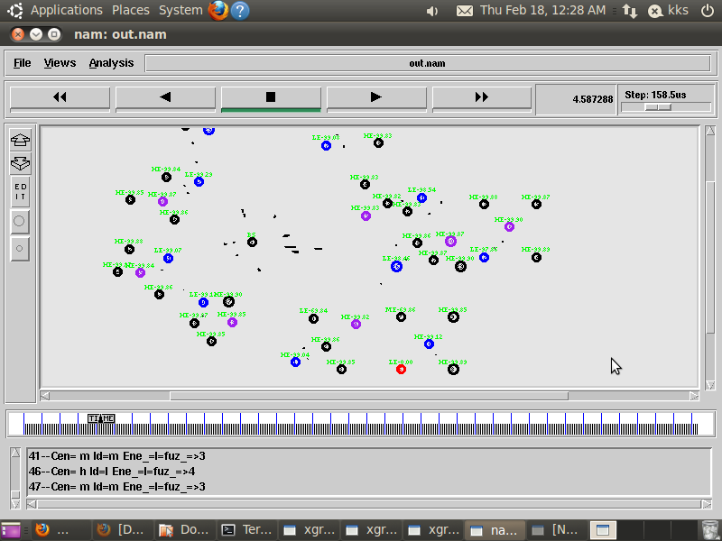
PROPER GRAY WHOLE DETECTION AND AVOIDANCE

Slide 32
DATA COMMUNICATION

Slide 33
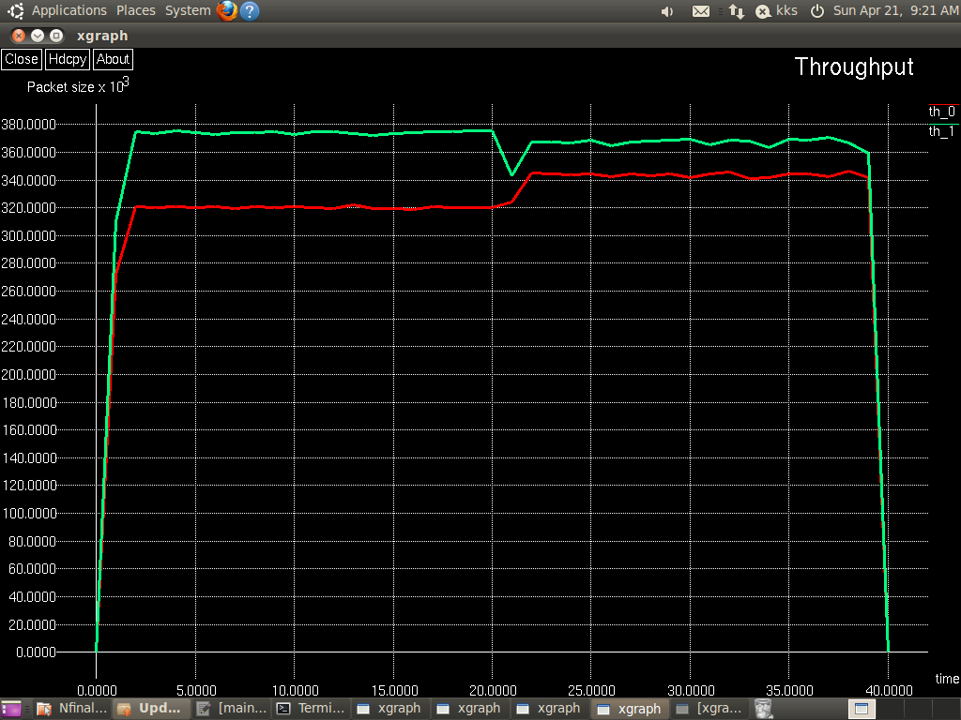
THROUGHPUT RESLUT

Slide 34
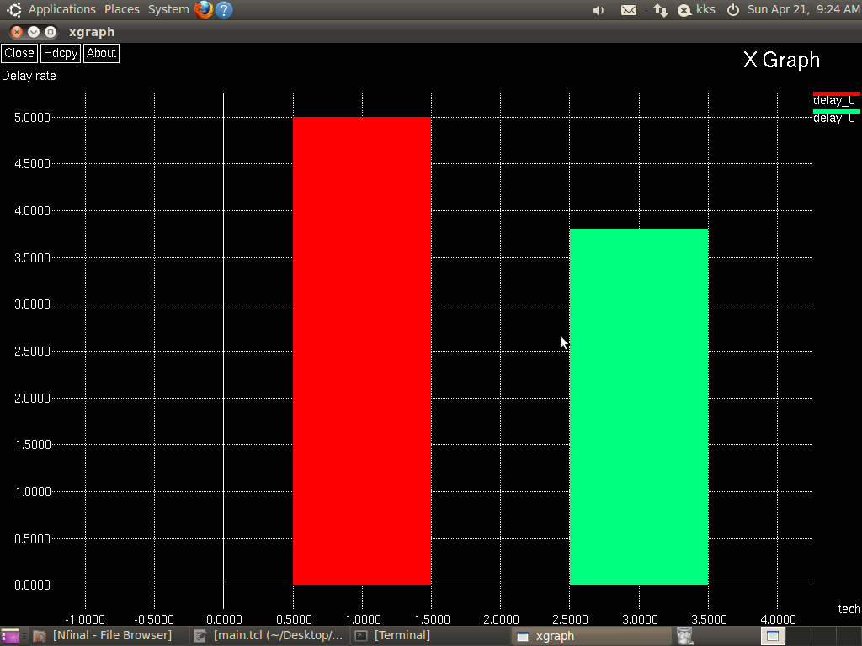
DELAY COMPARISON

Slide 35
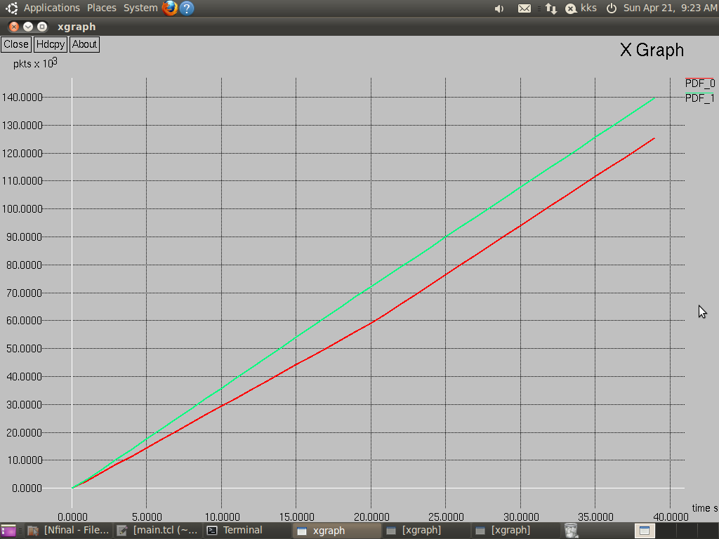
PDF

Slide 36
CONCLUSION
A GHA in VANETs is a type of security attack in which a malicious node exhibits unpredictable behavior.
It sometimes acts as an honest node, but later it starts misbehaving by partially, selectively, or completely dropping packets.
In this work, we presented a new and efficient approach for the detection and prevention of gray-hole attacks called DPGHA to improve the overall security and performance of AODV based VANETs.
The approach relies on multiple thresholds of abnormal differences among received, forwarded, and generated control/data packets and the sequence number of RREPs.

Slide 37
FUTURE ENHANCEMENT
Incorporating machine learning algorithms could improve the system's ability to adaptively identify and respond to evolving gray-hole attack strategies.
Integrating blockchain technology for decentralized trust management could enhance the resilience and scalability of the system, ensuring robustness against collusion attacks and providing transparent audit trails for trust assessments.
Exploring the integration of emerging communication technologies such as 5G and edge computing could enhance real-time detection and response capabilities, further fortifying VANETs against sophisticated cyber threats.

Slide 38
REFERENCES
[1] Z. Ahmed, S. Naz, and J. Ahmed, ‘‘Minimizing transmission delays in vehicular ad hoc networks by optimized placement of road-side unit,’’ Wireless Netw., vol. 26, pp. 1–10, Jan. 2020.
[2] J. Mahmood, Z. Duan, Y. Yang, Q.Wang, J. Nebhen, and M. N. M. Bhutta, ‘‘Security in vehicular ad hoc networks: Challenges and countermeasures,’’ Secur. Commun. Netw., vol. 2021, pp. 1–20, Jun. 2021.
[3] M. Lee and T. Atkison, ‘‘VANET applications: Past, present, and future,’’ Veh. Commun., vol. 28, Apr. 2021, Art. no. 100310.
[4] M. S. Sheikh and J. Liang, ‘‘A comprehensive survey on VANET security services in traffic management system,’’ Wireless Commun. Mobile Comput., vol. 2019, pp. 1–23, Sep. 2019.
[5] L. Huang, H. Jiang, Z. Zhang, Z. Yan, and H. Guo, ‘‘Efficient data traffic forwarding for infrastructure-to-infrastructure communications in VANETs,’’ IEEE Trans. Intell. Transp. Syst., vol. 19, no. 3, pp. 839–853, Mar. 2018.

Slide 39
THANK YOU

